Slide 1
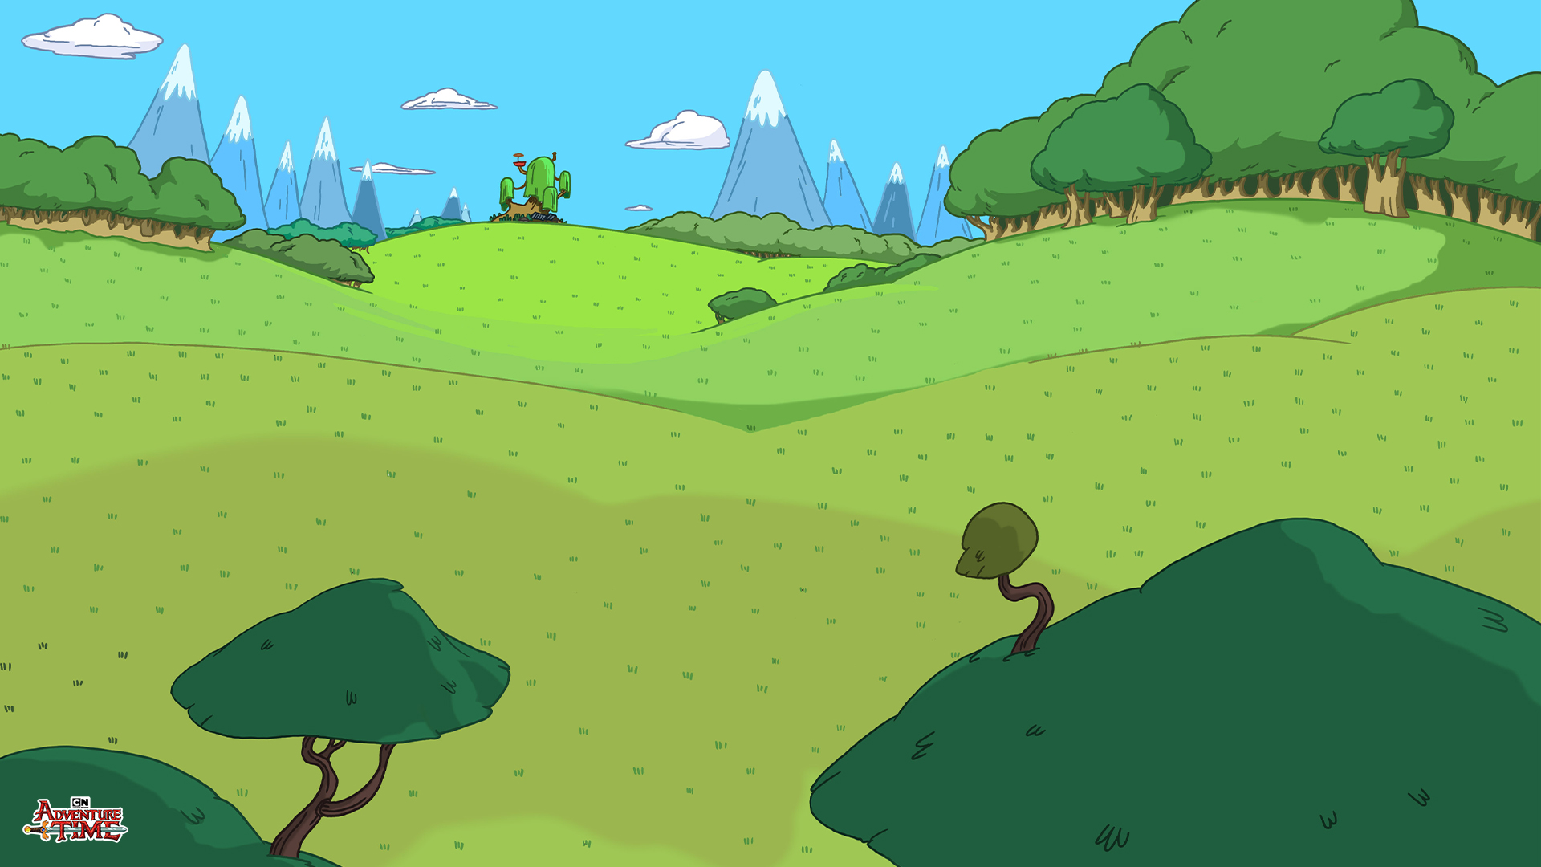
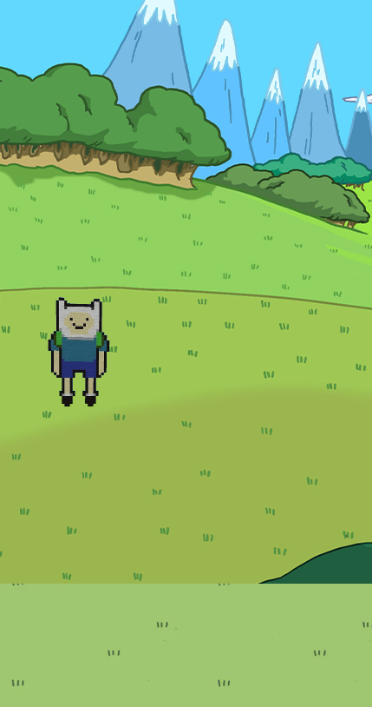
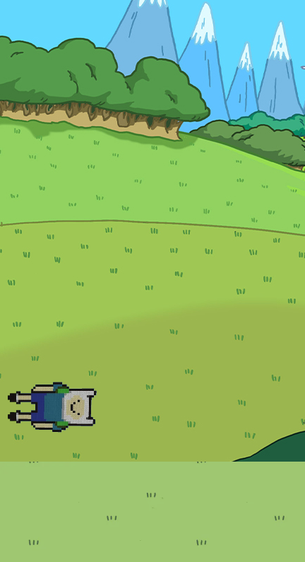
Flappy Time! (A Flappy Bird Clone)
https://github.com/ksu-is/Flappy-Time
Anita Nweke
Instead of a flapping bird, it's a flapping Finn!
The player will jump through the obstacles without touching them. Attempt to beat your high score!

